Slide 1
Training Neural Nets
CSCI 601 471/671
NLP: Self-Supervised Models
https://self-supervised.cs.jhu.edu/sp2023/
[Slide credit: Andrej Karpathy and many others ]

Slide 2
Logistics
Extra credit:
HW grades are out of 100%.
Gradescope might show >100 because of extra credits.
Midterm date: Tuesday March 7
In class, on paper
Purpose: your understanding of ideas presented in the first half of the semester
Based on: the lectures and weekly homework assignments
Scope: until the end of “Transformers”

Slide 3
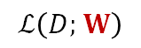
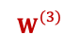
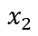
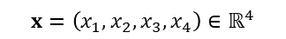

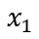
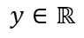
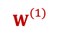
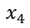
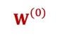
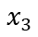

Recap: Training Neural Networks ~ Optimizing Parameters
We can use gradient descent to minimizes the loss.
At each step, the weight vector is modified in the direction that produces the steepest descent along the error surface.
$$ℒ\left(D;W\right)$$
$$W$$
$$W_{}^{(3)}$$
$$W_{}^{(2)}$$
$$W_{}^{(1)}$$
$$W_{}^{(0)}$$
$$x_{1}$$
$$x_{2}$$
$$x=\left(x_{1},x_{2},x_{3},x_{4}\right)∈ℝ^{4}$$
Weights to learn!
Weights to learn!
Weights to learn!
$$y∈ℝ$$
$$x_{3}$$
$$x_{4}$$

Slide 4
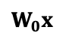
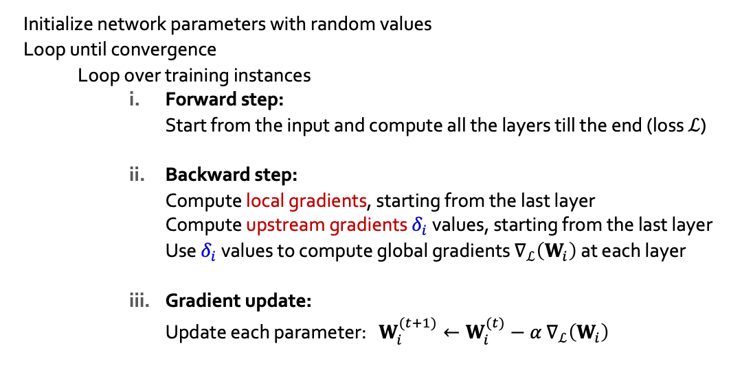
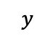
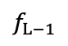
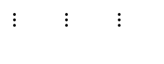
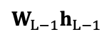
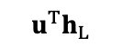
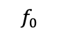

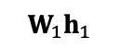
Recap: Back Propagation for Generic Neural Network:
$$y$$
$$u^{T}h_{L}$$
+
Initialize network parameters with random values
Loop until convergence
Loop over training instances
Forward step: Start from the input and compute all the layers till the end (loss $ℒ$)
Backward step: Compute local gradients, starting from the last layer Compute upstream gradients $δ_{i}$ values, starting from the last layer Use $δ_{i}$ values to compute global gradients $∇_{ℒ}\left(W_{i}\right)$ at each layer
Gradient update: Update each parameter: $W_{i}^{(t+1)}←W_{i}^{(t)}−α$ $∇_{ℒ}\left(W_{i}\right)$
$$f_{L−1}$$
In practice, this step is done over batches of instances!
$$W_{L−1}h_{L−1}$$
$⋮ ⋮$ $⋮$
$$W_{1}h_{1}$$
$$f_{0}$$
$$W_{0}x$$
$$x$$

Slide 5
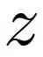
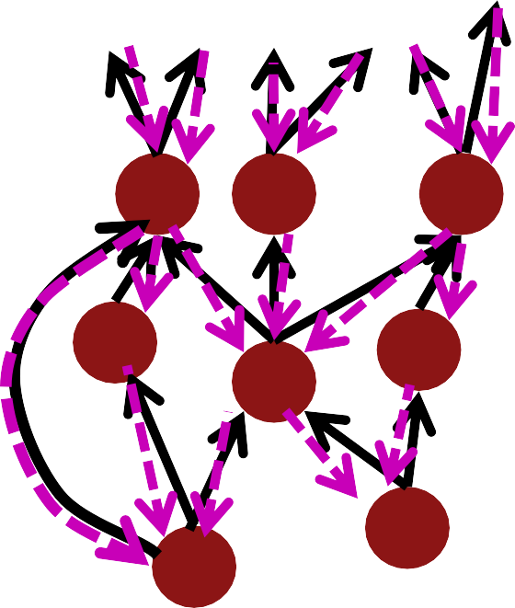
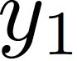
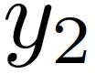
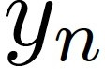

Recap: Backprop in General Computation Graph
Single scalar output
What if the network does not have a regular structure? Same idea!
Sort the nodes in topological order (what depends on what)
Forward-Propagation:
Visit nodes in topological sort order and compute value of node given predecessors
Backward-Propagation:
Compute local gradients
Visit nodes in reverse order and compute global gradients using gradients of successors
…
…
Inputs

Slide 6
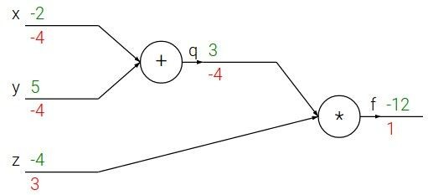
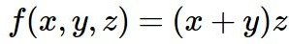
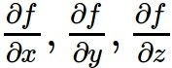
Recap: Backprop in PyTorch
Want:
x = torch.tensor(-2.0, requires_grad=True)
y = torch.tensor(5.0, requires_grad=True)
z = torch.tensor(-4.0, requires_grad=True)
f = (x+y)*z # Define the computation graph
f.backward() # PyTorch’s internal backward gradient computation print('Gradients after backpropagation:', x.grad, y.grad, z.grad)

Slide 7
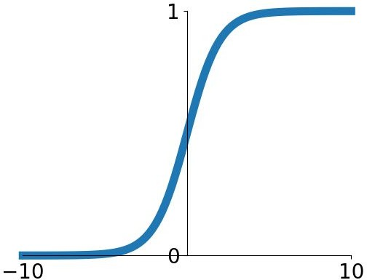
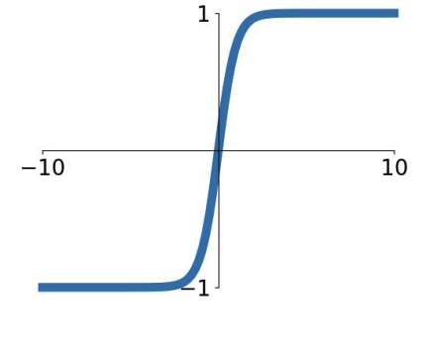
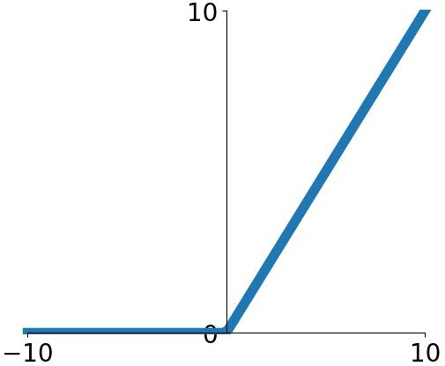
Recap: Activation Function Pros/Cons
Sigmoid Tanh ReLU
A useful recipe:
Generally, ReLU is a good activation to start with.
Time/compute permitting, you can try other activations to squeeze out more performance.

Slide 8
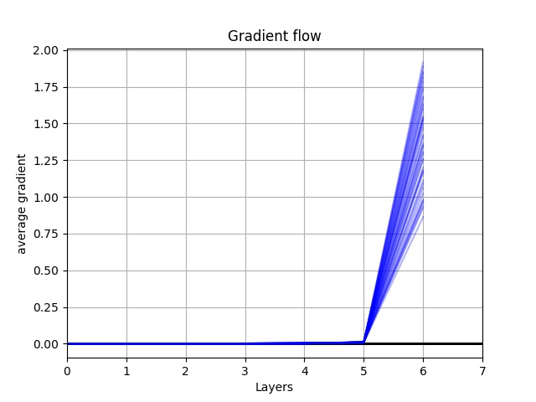
Exploding/Vanishing Gradients
If many numbers |x| > 1 get multiplied, the result will become too big.
NaN gradients --> no learning!
If many numbers |x| < 1 get multiplied, the result will become too small.
Zero gradients -> no learning!

Slide 9
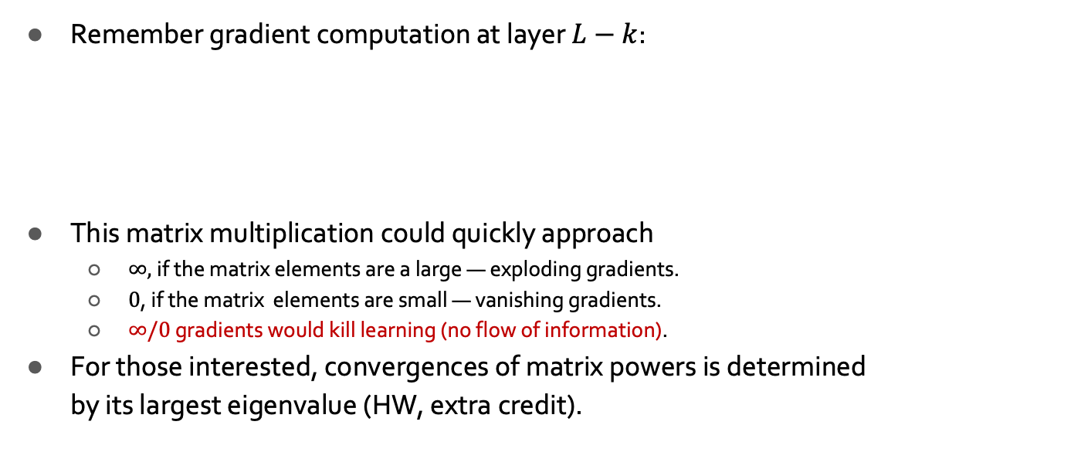
Exploding/Vanishing Gradients
$$y$$
$$u^{T}h_{L}$$
+
Remember gradient computation at layer $L−k$:
This matrix multiplication could quickly approach
$∞,$if the matrix elements are a large — exploding gradients.
$0$, if the matrix elements are small — vanishing gradients.
$∞/0$ gradients would kill learning (no flow of information).
For those interested, convergences of matrix powers is determined by its largest eigenvalue (HW, extra credit).
$$f_{L−1}$$
$$∇_{ℒ}\left(W_{L−k}\right)={\left(J_{ℓ}\left(y\right){ J}_{y}\left(h_{L}\right){ J}_{h_{L}}\left(h_{L−1}\right){ J}_{h_{L−1}}\left(W_{L−2}\right)…{ J}_{h_{L−k+1}}\left(W_{L−k}\right)\right)}^{T}$$
$$W_{L−1}h_{L−1}$$
O(k)-many matrix multiplication
$⋮ ⋮$ $⋮$
$$W_{1}h_{1}$$
$$f_{0}$$
$$W_{0}x$$
$$x$$

Slide 10
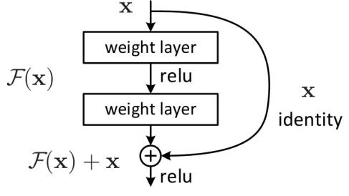
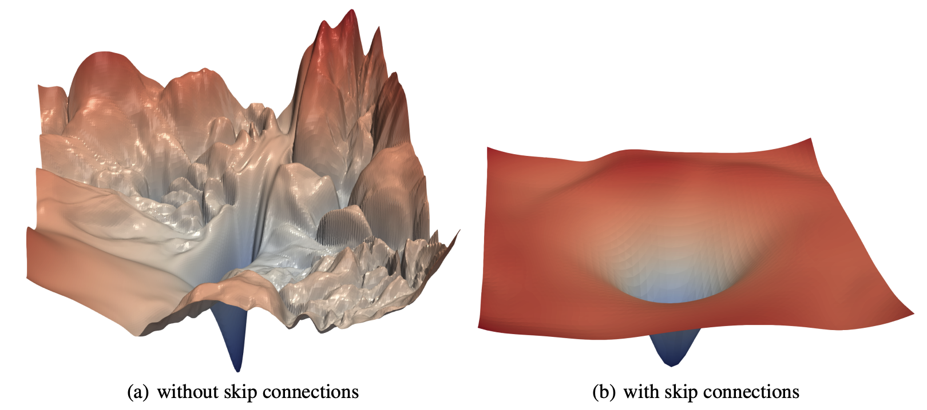
Residual Connections/Blocks
Create direct “information highways” between layers.
Shown to diminish vanishing/exploding gradients
Early in the training, there are fewer layers to propagate through.
The network would restore the skipped layers, as it learns richer features.
It is also shown to make the optimization objective smoother.
[Fun fact: the paper (He et al. 2015) introducing residual layers is the most cited paper of century!!]
[Li et al. “Visualizing the Loss Landscape of Neural Nets”]

Slide 11
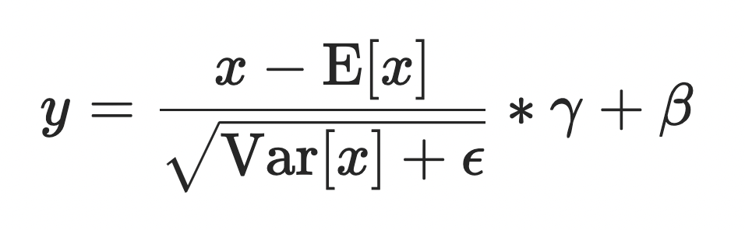
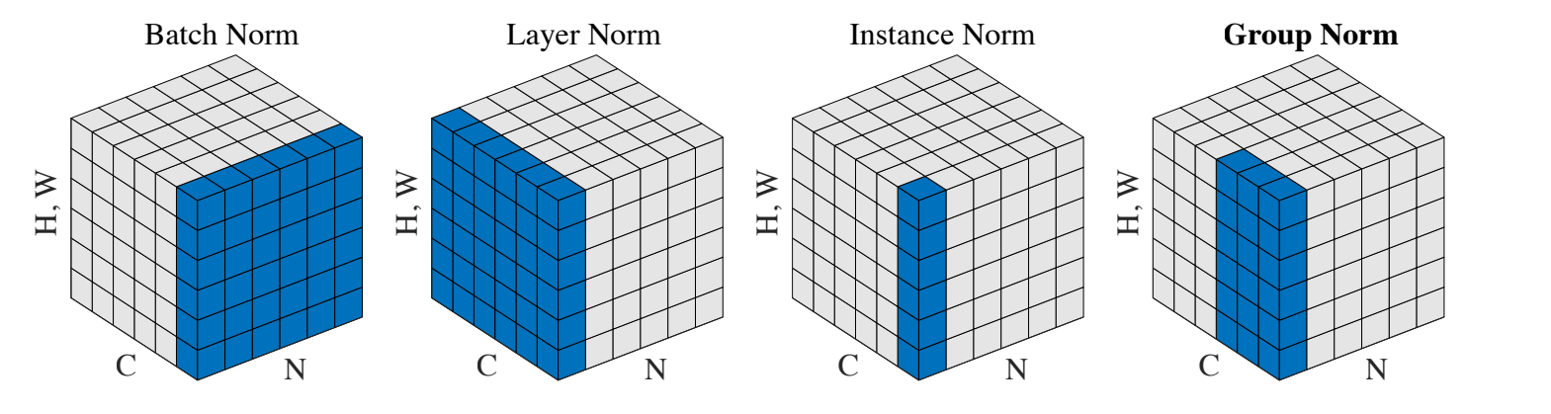
Normalization: Layer, Batch, …
Normalization of values standardizes the ranges of values
Prevents value disparities
Stabilizes and speeds up training
See PyTorch documentations: https://pytorch.org/docs/stable/nn.html#normalization-layers
[Ba et al. “Layer Normalization”]

Slide 12
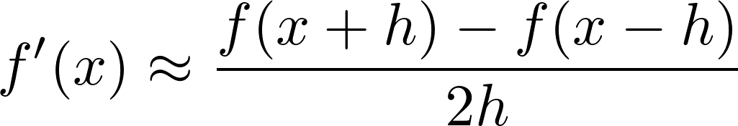
Manual Gradient checking: Numeric Gradient
For small h (≈ 1e-4),
Easy to implement correctly
But approximate and very slow:
You have to recompute f for every parameter of our model
Useful for checking your implementation
In the old days, we hand-wrote everything, doing this everywhere was the key test
Now much less needed; you can use it to check layers are correctly implemented

Slide 13
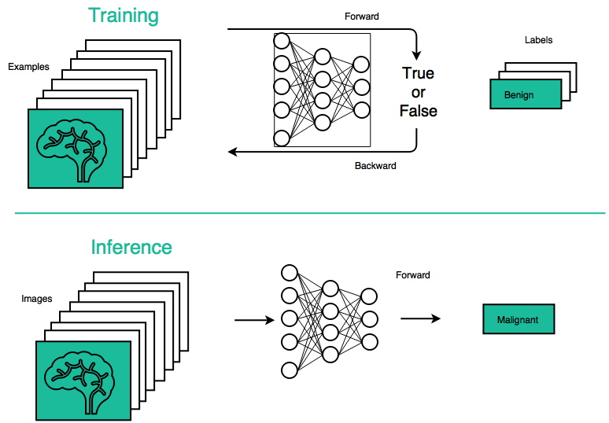
Batching
GPUs are fast with Tensor operations
Rather than visiting instances in sequentially , batch them together for faster training and inference.

Slide 14
Weight Initialization
Initializing all weights with a fixed constant (e.g., 0’s) is a very bad idea! (why?)
If the neurons start with the same weights, then all the neurons will follow the same gradient, and will always end up doing the same thing as one another.
Effective initialization is one that breaks such ”symmetries” in the weight space.

Slide 15
Weight Initialization
Better idea: initialize weights with random Gaussian noise.
There are fancier initializations (Xavier, Kaiming, etc.) that we won’t get into.
x = torch.tensor.empty(3, 5)
nn.init.normal_(w)
[read more here: https://pytorch.org/docs/stable/nn.init.html]

Slide 16

Over-training Prevention
Running too many epochs and/or a NN with many hidden layers may lead to an overfit network
Keep a held-out validation set and evaluate accuracy after every epoch
Early stopping: maintain weights for best performing network on the validation set and return it when performance decreases significantly beyond that.

Slide 17
Over-fitting prevention
Too few hidden units prevent the system from adequately fitting the data and learning the concept.
Using too many hidden units leads to over-fitting.
Similar cross-validation method can be used to determine an appropriate number of hidden units. (general)
Another approach to prevent over-fitting is weight-decay: all weights are multiplied by some fraction in (0,1) after every epoch.
Encourages smaller weights and less complex hypothesis
Equivalently: change Error function to include a term for the sum of the squares of the weights in the network. (general)

Slide 18
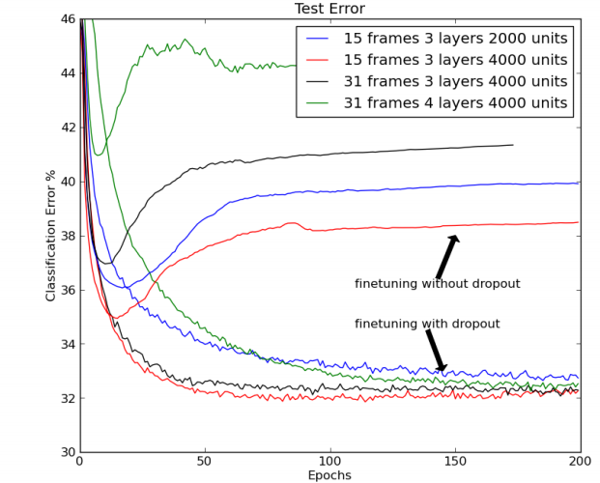
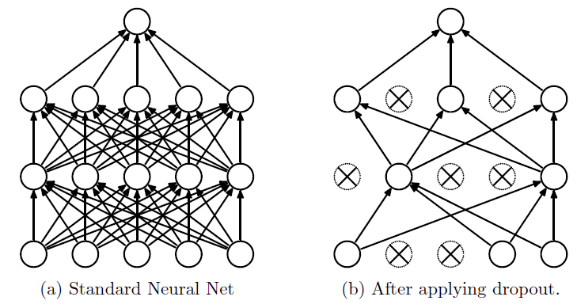
Dropout Training
In each forward pass, randomly set some neurons to zero
Probability of dropping is a hyperparameter; 0.5 is common
Dropout is implicitly an ensemble (average) of model that share parameters.
Each binary mask is one model
For example, a layer with 4096 units has 2⁴⁰⁹⁶ ~ 10¹²³³ possible masks!
Only ~ 10⁸² atoms in the universe ...
[Hinton et al, 2012; Srivastava et al, “Dropout: A simple way to prevent neural networks from overfitting”, JMLR 2014]

Slide 19
Dropout During Test Time
The issue for the test time:
Dropout adds randomization. ☹
Each dropout mask would lead to a slightly different outcome.
In ideal world, we would like to “average out” the outcome across all the possible random masks:
Not feasible.
Remember the example: a layer with 4096 units has 2⁴⁰⁹⁶ ~ 10¹²³³ possible masks!
Only ~ 10⁸² atoms in the universe ...

Slide 20


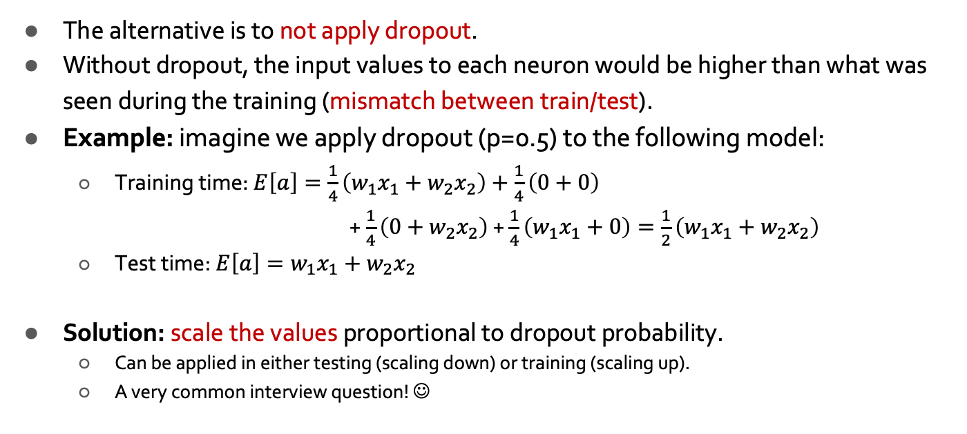
Dropout During Test Time (2)
The alternative is to not apply dropout.
Without dropout, the input values to each neuron would be higher than what was seen during the training (mismatch between train/test).
Example: imagine we apply dropout (p=0.5) to the following model:
Training time: $E\left[a\right]=\frac{1}{4}\left(w_{1}x_{1}+w_{2}x_{2}\right)+\frac{1}{4}\left(0+0\right)$ + $\frac{1}{4}\left(0+w_{2}x_{2}\right)$ + $\frac{1}{4}\left(w_{1}x_{1}+0\right)=\frac{1}{2}\left(w_{1}x_{1}+w_{2}x_{2}\right)$
Test time: $E\left[a\right]=w_{1}x_{1}+w_{2}x_{2}$
Solution: scale the values proportional to dropout probability.
Can be applied in either testing (scaling down) or training (scaling up).
A very common interview question! ☺
a
w₁
w₂
x
y

Slide 21
Dropout in Practice
dropout = nn.Dropout(p=0.2)
x = torch.randn(20, 16)
y = dropout(x)
Just call the PyTorch function!
It automatically
activates the dropout for training.
deactivatives it during evaluations and scales the values according to its parameter.
# training step
...
model.train()
...
# evaluate model:
...
model.eval()
...
See PyTorch documentations https://pytorch.org/docs/stable/generated/torch.nn.Dropout.html

Slide 22
The Only Time You Want to Overfit: The First Tryout
A model with buggy implementation (e.g., incorrect gradient calculations or updates) cannot learn anything.
Therefore, a good and easy sanity check is to see if you can overfit few examples.
This is really the first test you should do, before any hyperparameter tuning.
Try to train to 100% training accuracy/performance on a small sample (<30) of training data and monitor the training loss trends.
Does it down? If not, something must be wrong.
Try checking the learning rate or modifying the initialization.
If those don’t help, check the gradients.
If they’re NaN or Inf, might indicate exploding gradients.
If they’re zeros, might indicate vanishing gradients.

Slide 23
Additional Comments on Training
No guarantee of convergence; neural networks form non-convex functions with multiple local minima
In practice, many large networks can be trained on large data.
Many steps (tens of thousands) may be needed for adequate training.
May be tricky to set learning rate or number of hidden units/layers.
To avoid local minima: several trials with different random initial weights with majority or voting techniques

Slide 24
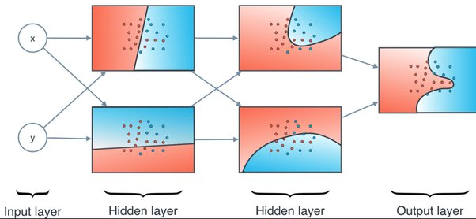
Intuition about Neural Net Representations

Slide 25
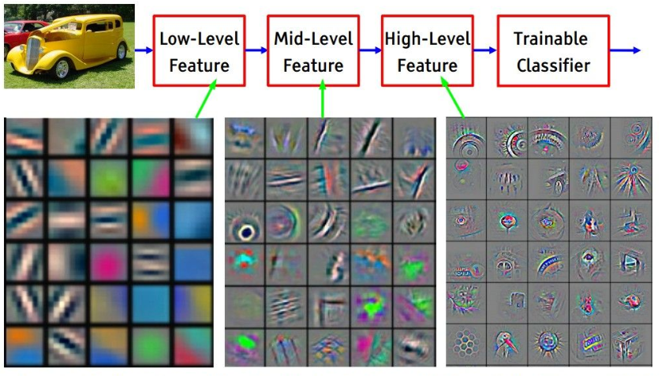
Intuition about Neural Net Representations
[Zeiler & Fergus 2013; Yosinski et al. 2015]

Slide 26
TODO: Gradient Accumulation

Slide 27
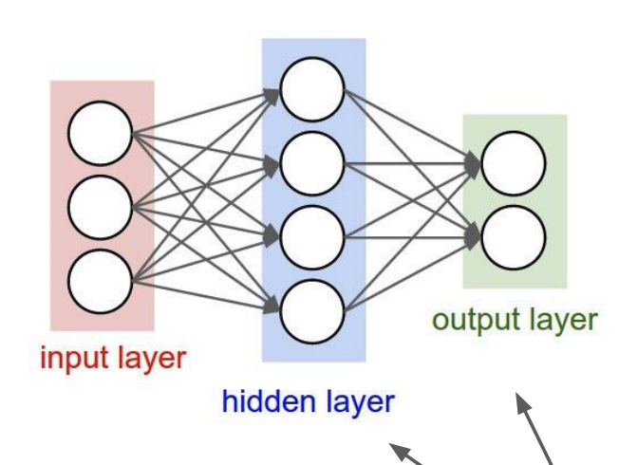
Neural Networks: Summary
Feed-forward network architecture
Word2Vec is just a feedforward net!
And we can easily extend it!
We learned Backprop, the most important algorithm in neural networks! 🎉
Recursively (and hence efficiently) apply the chain rule along computation graph
Lots of empirical tricks for training neural networks:
First test: check if you can overfit.
Dropout
Be mindful of activations
Careful of exploding/vanishing gradients

